Slide 1
Visualization in Excel
Spring Semester 2020

Slide 2
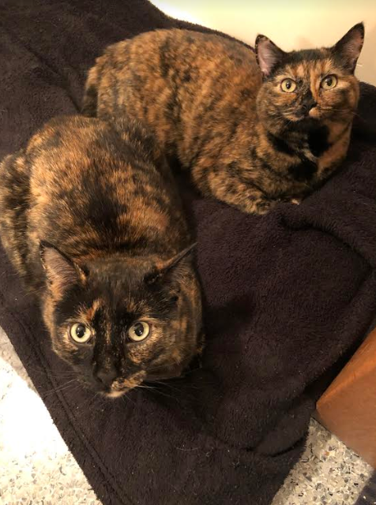

Working at home…
Dorothy and Josephine are visualizing a play session with their laser toy

Slide 3
Agenda
Basics of Visualization
Clustered Bar Charts
Pie Charts
Slopegraphs
Benchmark Line
Butterfly Charts
Stacked Bar Chart
Confidence Intervals
Time Stamp Line
Icon Arrays
Chart, graph— what’s the difference?
Charts present information in graphs, diagrams and/or tables. Graphs comprise a specific type of chart, showing the relationships between mathematical data.
SLIDE CREDITS:
Kimberly Rubens
Juliet Flores Wilson
Ann Glusker

Slide 4
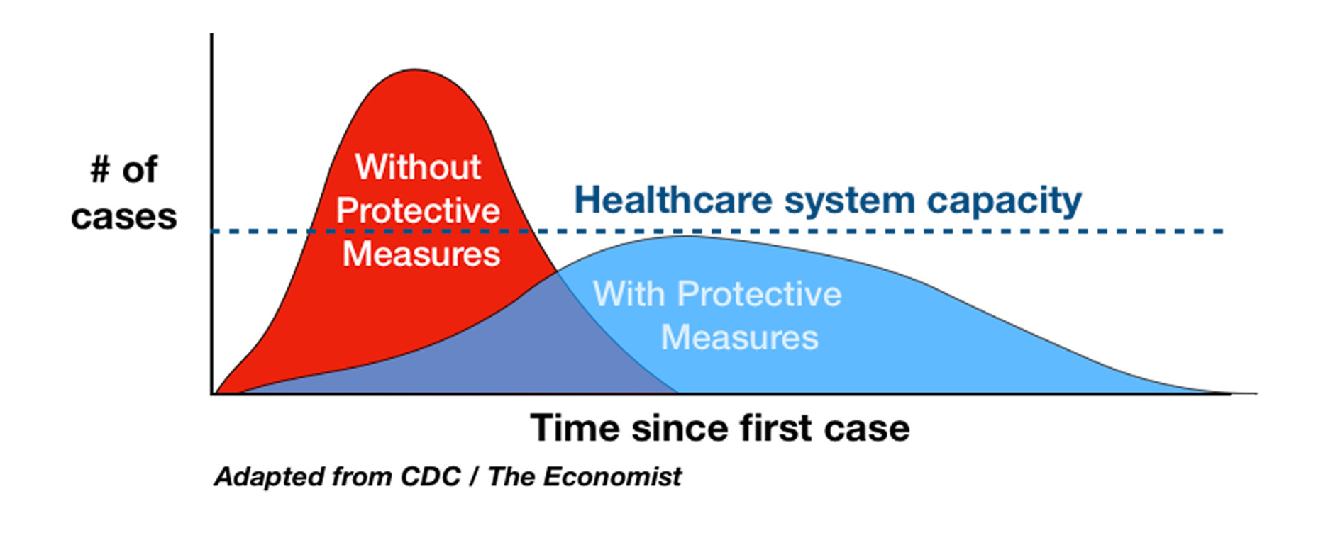
A picture is worth 1,000 words

Slide 5
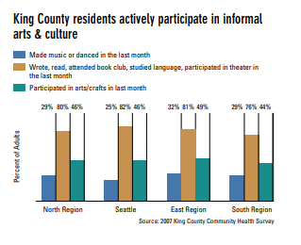
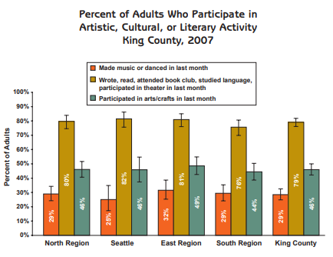
This class is the tip of the iceberg…
We’ll focus on the processes of creating and formatting charts for reports and presentations—more technique than theory!
Best practices for academic audiences (conferences, papers) may differ from the ones in this class.
Images: Public Health- Seattle & King County, “Communities Count: 2008”

Slide 6
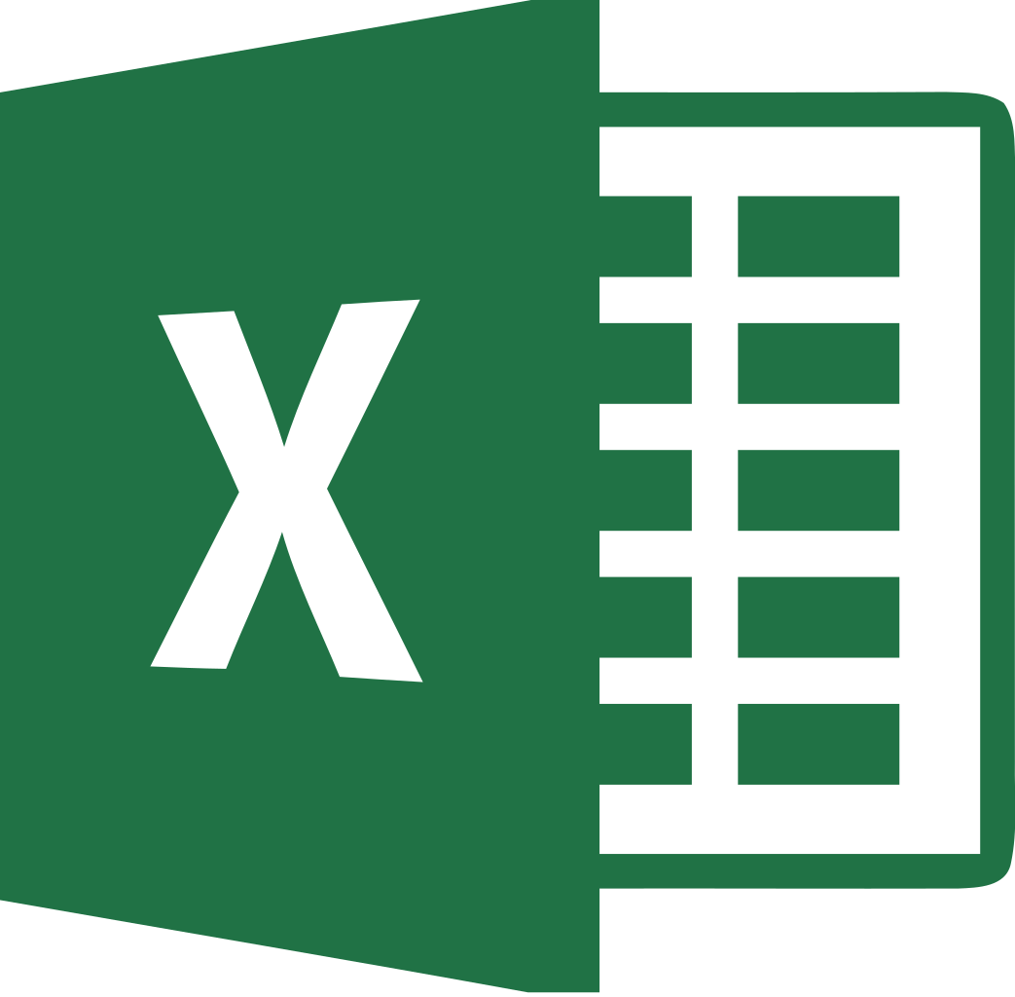

Excel is great for data viz, but other tools exist:
Good for:
Reports or other “static” documents
Datasets that aren’t frequently updated
Need to make a few quick charts
“Straightforward” visuals
Good for:
Interactive dashboards
Regularly updated datasets
Online applications
More “advanced” visuals
Creating an online tool
Also consider ggplot in R !

Slide 7
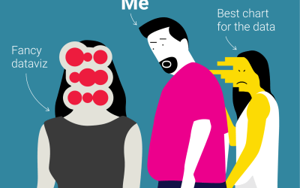
Is it honest? Is it clear? Is it persuasive?
Data Visualization: Guiding Questions
Good visualizations draw the viewers’ focus to the substance of the information being reported, rather than the methodology, graphic design, or something else.
Viewers should be able to grasp the point of what they’re looking at quickly, even for complicated subjects
Avoid distorting what the data have to say
Make large data sets coherent
Base content on good analysis
Better than giving someone a table of numbers, in most cases

Slide 8
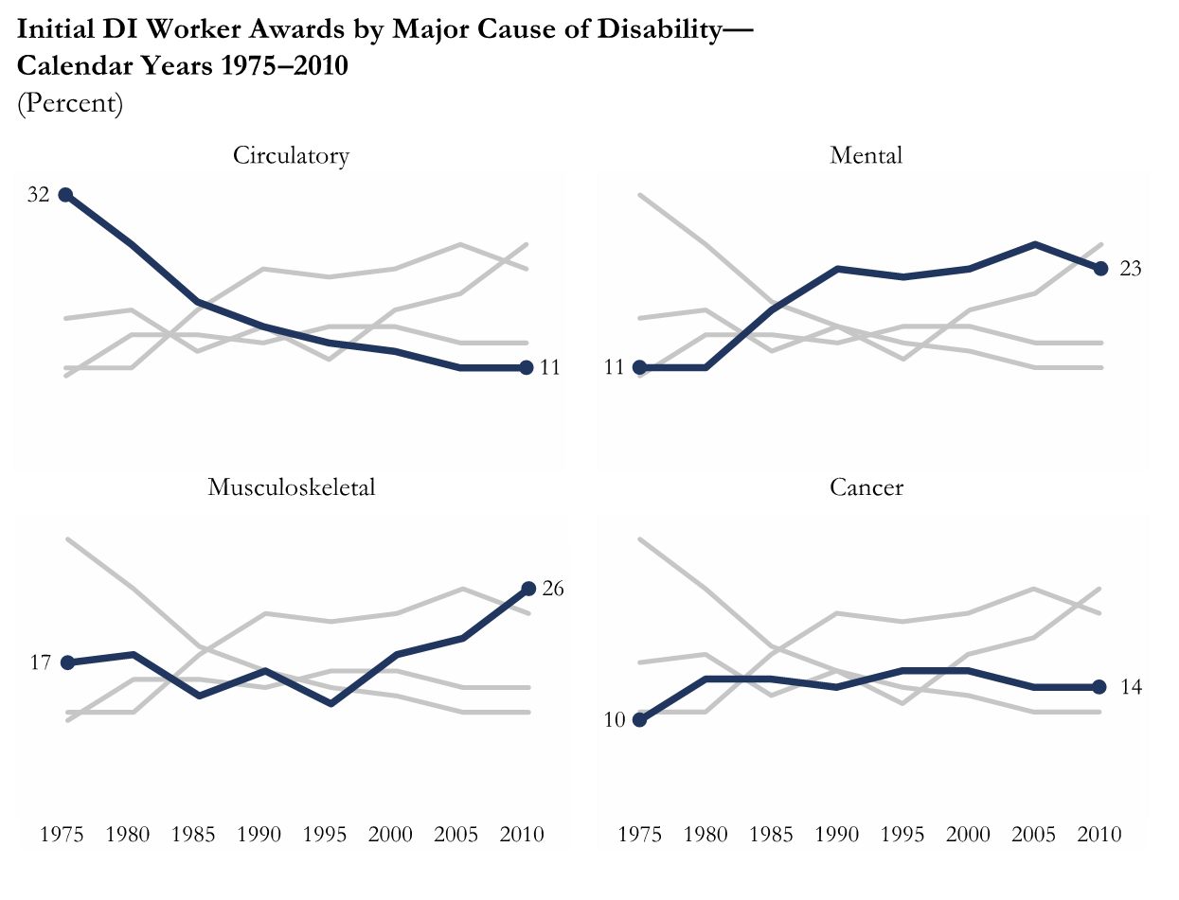
How you present information matters

Slide 9

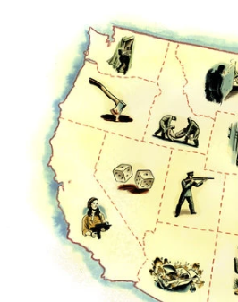
How you present information matters
Great use of icons!
(CA’s is Patty Hearst)
https://www.nytimes.com/2019/07/26/books/50-states-of-true-crime.html

Slide 10
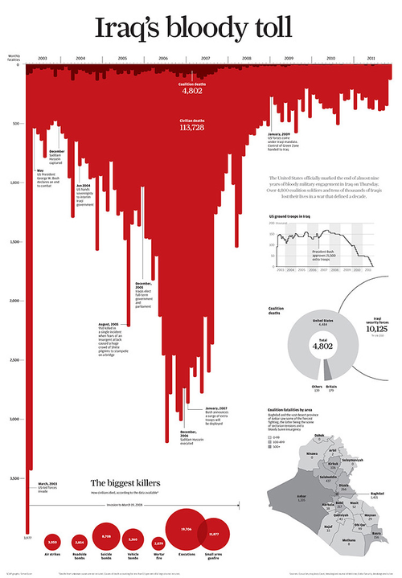
This award winning infographic was created in 2011, at the end of the Iraq war, and uses red colors and imagery of dripping blood to make its point
http://www.simonscarr.com/iraqs-bloody-toll

Slide 11
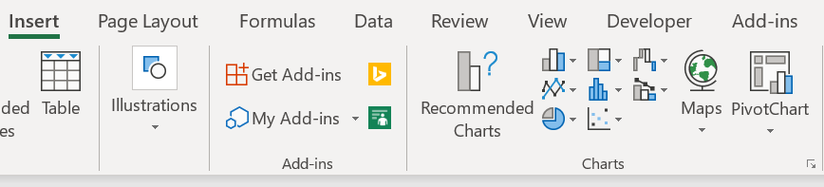
Excel is great for data viz, but other tools exist:
Choosing the right visualization for your data
What would you like to show?
(Excel will suggest the best options for visualizing your data under “Recommended Charts”).
I want to compare two or more values:
Bar chart
Line chart
Slope graph
Tornado/butterfly chart
I want to show the composition of something:
Stacked bar chart
Pie chart
Area chart
I want to show the distribution of something:
Histogram
Scatter plot
I want to show the relationship between variables:
Scatter plot

Slide 12



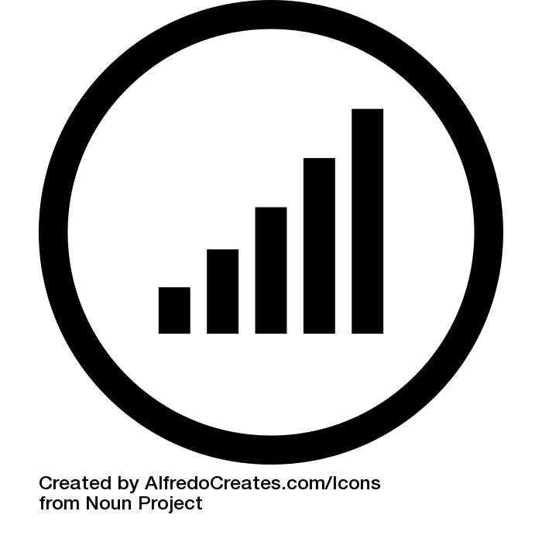
Data Visualization Best Practices
Do the colors make sense?
Are the colors not red and green?
Did I use a tasteful (~3) amount of color?
Have I refrained from using weird fading options?
Is the text professional?
Is there a title?
If possible, is the title active?
Is there a short descriptive sentence?
Is everything grammatically correct?
Is it well aligned?
Are the numbers big enough to read?
Are my units labeled if necessary?
Is there a comparison?
Is that comparison clear?
Have I deleted unnecessary grid lines?
Is my data sourced in the bottom right or left hand corner?

Slide 13
Formatting Basics in Excel
Insert | Page Layout | Chart Design | Formatting Sidebar
Where you insert a chart into workbook | Where you change design colors. NEVER USE EXCEL PRESET COLORS | Where you can change the type of chart | Where you can use Excel witchcraft to make visualizations that are aesthetically pleasing while retaining intellectual integrity

Slide 14
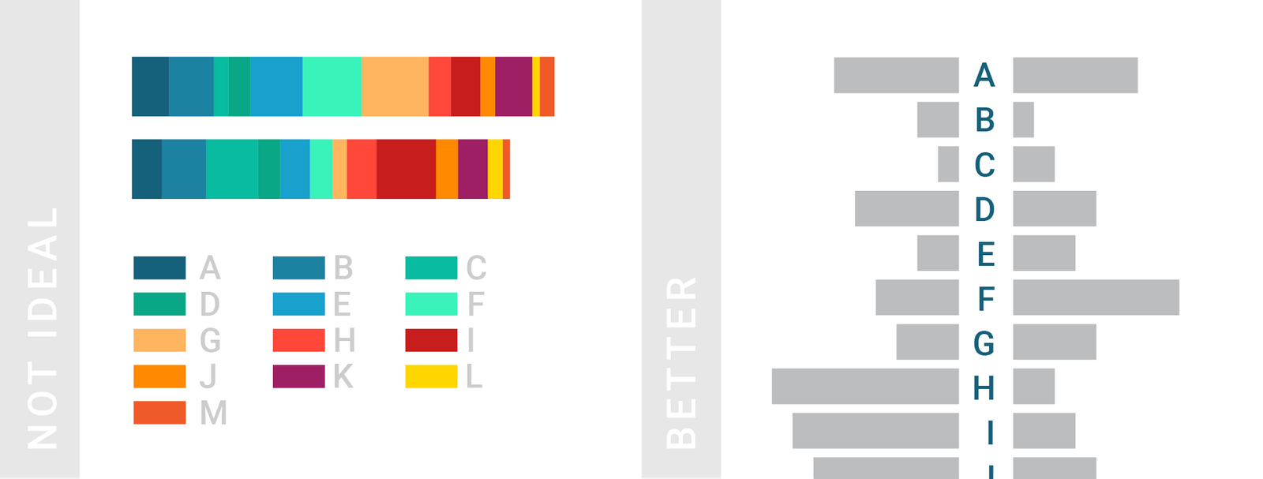
On color choice…
Source: https://www.dataquest.io/blog/what-to-consider-when-choosing-colors-for-data-visualization/

Slide 15
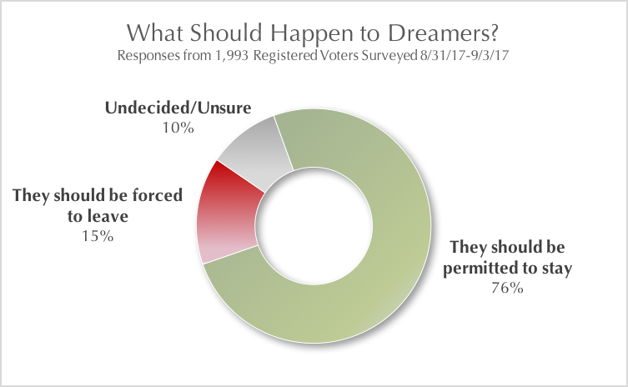
Do not…
ISSUES:
Not sourced
Uses red and green
Weird fading options
Title is good but doesn’t have enough contrast
Data isn’t aligned at 0%

Slide 16
Do not…
Basically: avoid visual elements that don’t say anything about the data (3-D!!)

Slide 17
Agenda
Dear Mac users! The instructions below are for PCs. But they’ve all been tested on a Mac, with Excel 2016. Just remember, where you see “right click” use “Control click” (NOT Command); and, if what you want doesn’t pop up, click on the chart, then on the “Chart Design” tab, and choose “Add Chart Element” on the top left. You will be offered the options you need!
Basics of Visualization
Clustered Bar Charts
Pie Charts
Slopegraphs
Benchmark Line
Butterfly Graphs
Stacked Bar Graph
Confidence Intervals
Time Stamp Line
Icon Arrays

Slide 18
Clustered Bar Chart: Before

Slide 19
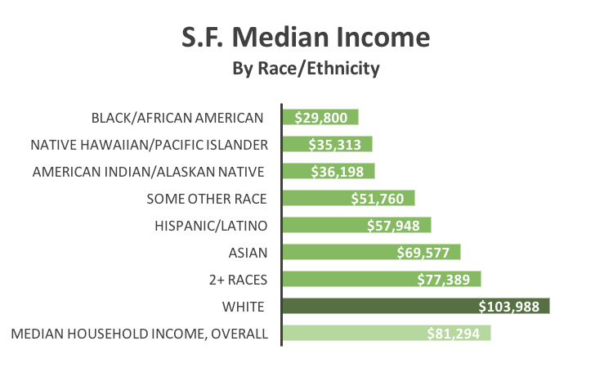
Clustered Bar Chart: After

Slide 20
Clustered Bar Chart Instructions
1 | Select the design colors you would like to use under the ”Page Layout” tab. I like “Blue Warm.”
2 | Select the data A3:B11 in the workbook, don’t forget keyboard shortcuts!
3 | On the Excel Ribbon, go to Insert tab, select the first chart this is recommended, ”Clustered Bar Graph”
4 | Give your chart a title, make the text darker
5 | Delete the vertical lines (highlight them, and hit delete), x-axis labels (Format chart→Format axis→Labels)
6 | Sort your data: select A3:B11, click the sort button under the data tab, choose column B, “largest to smallest”
7 | Under Chart Design, use the “Add Chart Element” dropdown menu to add a data label to your chart, choose inside end Highlight the series, click “Add Data Labels”, then format the labels once added
8 | Change the color of the text of the Data Label by clicking one of the numbers, and using the tools available under “Text Options” that pops up on the right hand side
9 | Make the y-axis labels bigger, change the y-axis font
10 | Make the bar separating the y-axis labels and stacked bars thicker: click on the y-axis labels, under the paint can tab, play around with the solid line formatting features under the tab “line”
11 | Make the horizontal bars bigger by changing the “Gap width,” it is the third tab on the ”Format Series” toolbar that pops up
12 | Change the color of the Median Income bar by clicking twice on that bar.

Slide 21
Agenda
Basics of Visualization
Clustered Bar Graphs
Pie Charts
Slopegraphs
Benchmark Line
Butterfly Graphs
Stacked Bar Graph
Confidence Intervals
Time Stamp Line
Icon Arrays

Slide 22
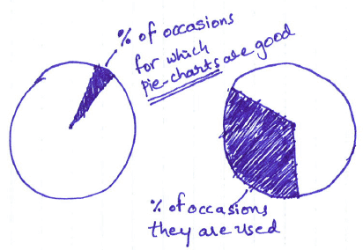
Pie Charts
We’re aiming for this
The case for pie charts…
Circular shape quickly indicates something is part of a whole.
They make it easy to see if different values, when combined, are larger than another value.
Immune to distortion caused by a change in scale – unlike bar charts.
Pretty straightforward if kept simple.

Slide 23
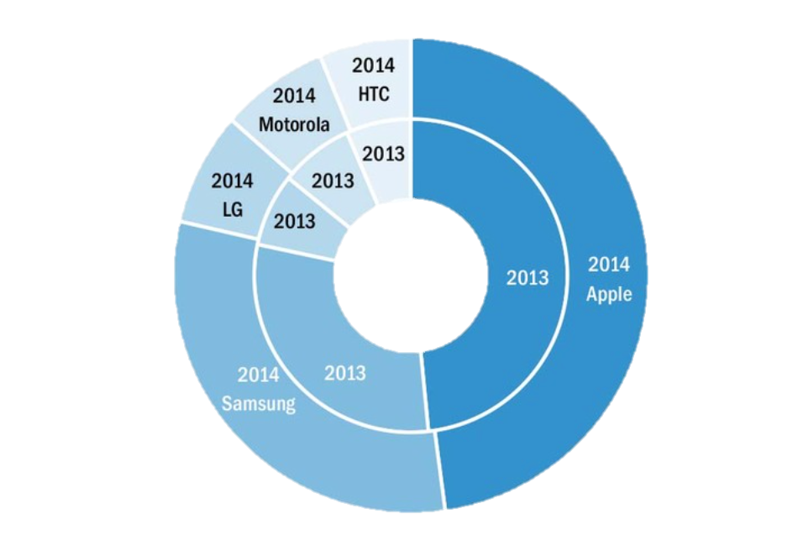
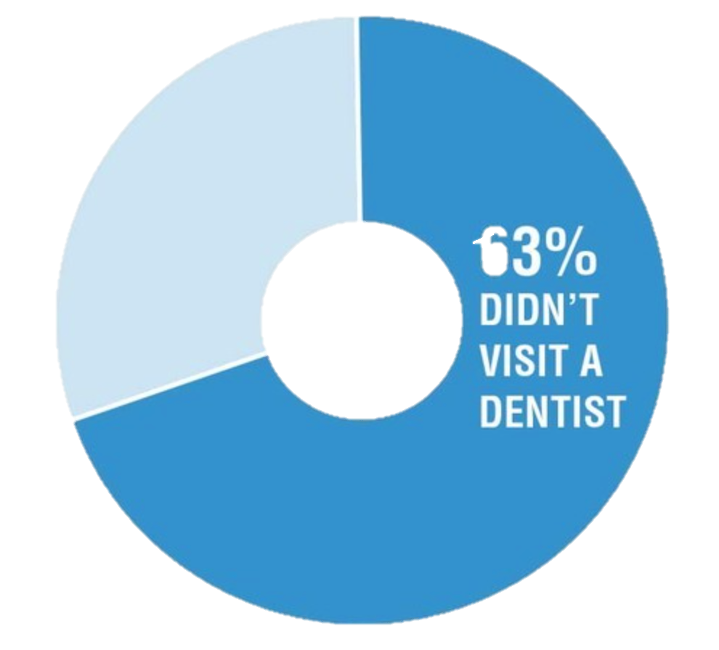
Pie Charts
Pie charts are best if you only want to use two or three data points (no slivers!). And donut charts can be confusing! On the other hand, a donut chart can be used to highlight one number; in this example, it helps give the magnitude of the percentage. Use your judgment!
Effective Data Visualization, Evergreen, p.15

Slide 24
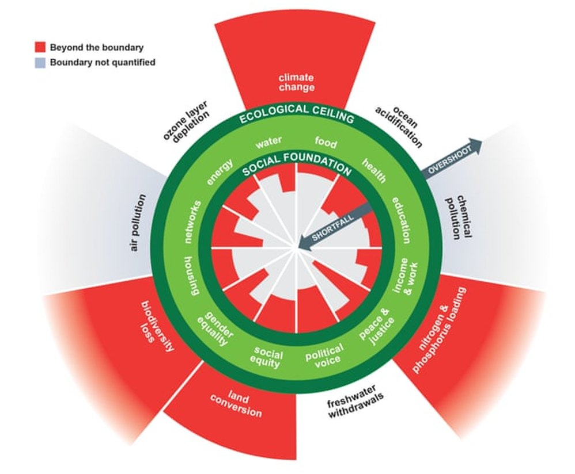
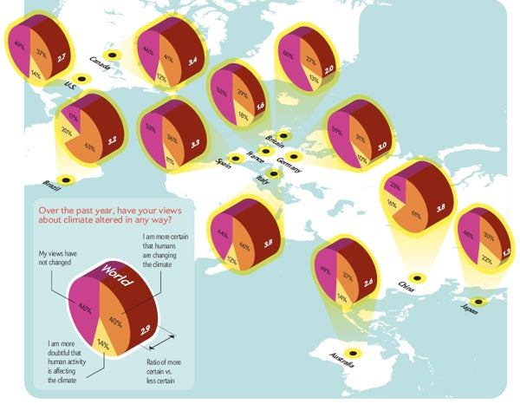
Pie Charts: Oh boy…

Slide 25
Pie Charts
DO | DON’T
Limit the number of “slices” you use – try to keep it at 5 or less Organize data from largest to smallest value Use when trying to show proportions that add up to 100% Make sure colors can be easily distinguished from one another Add labels if they don’t make your chart too busy Keep it simple! | Compare ratios that add up to more than 100% Compare two pie charts side by side – use a different chart. Use 3D

Slide 26
Pie Chart Instructions
1 | Select design colors under the ”Page Layout” tab. If you change the design colors in one sheet it’ll change the design colors in the whole workbook.
2 | Select all the data in the workbook, A9:B10, don’t forget keyboard shortcuts!
3 | On the Excel Ribbon, go to Insert tab, select pie image, then doughnut
4 | Reduce the doughnut hole size by double clicking on the ring, then reducing the percentage of the donut hole.
5 | Add a chart title, make sure it’s clear and active if possible
6 | Remove the border of the donut by toggling over to the paint can while the sidebar says “Format Data Series” and check “no line” under “Border”
7 | Delete the legend entry
8 | Add a textbox. Feel free to write “97% of respondents thought Kimberly’s first class last semester was spectacular!”
9 | Add data label to the pie chart by right clicking on the pie chart then selecting data labels
10 | Format data labels by using Excel formatting tools for text size and color under the home tab
11 | Format chart title so that it’s no longer grey. Also right or left align your title. The Excel default for titles is to use grey which is ugly and not helpful for legibility purposes. You can format the title text by using the formatting options under the home tab. Don’t forget to make sure the text is professional and legible

Slide 27
Agenda
Basics of Visualization
Clustered Bar Charts
Pie Charts
Slopegraphs
Benchmark Line
Butterfly Graphs
Stacked Bar Graph
Confidence Intervals
Time Stamp Line
Icon Arrays

Slide 28
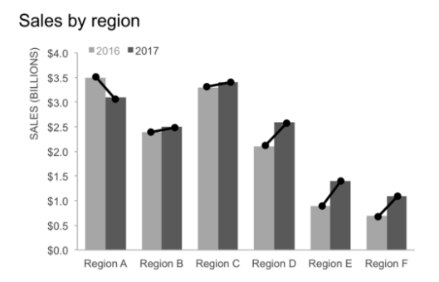

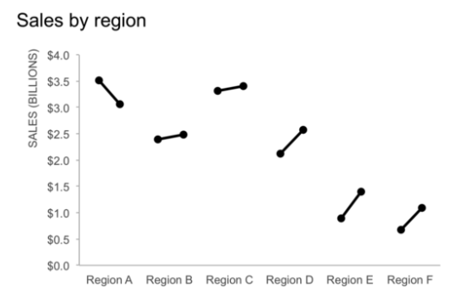
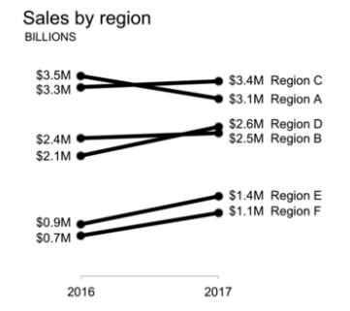
Slopegraphs
Good for:
Before and after comparisons
Comparing the relationship between categories across two different quantitative values
Bad for:
Showing any trends/changes that occurred between the two time periods you are comparing
Quick visualizations – these take a while to put together! (At least in Excel).
Images: http://www.storytellingwithdata.com/blog/2018/6/1/swdchallenge-slopegraph

Slide 29
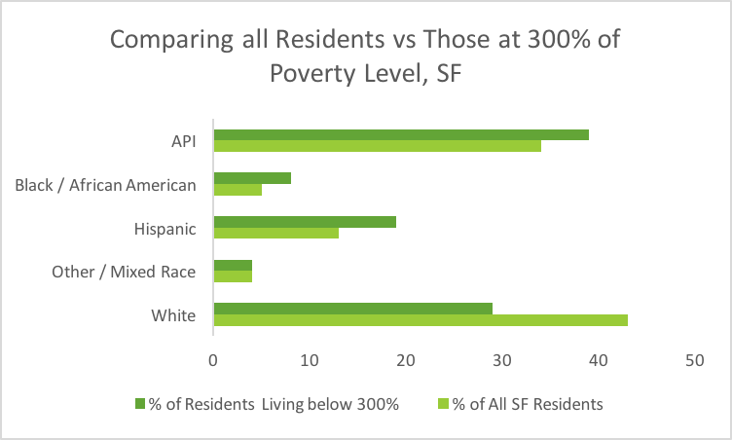
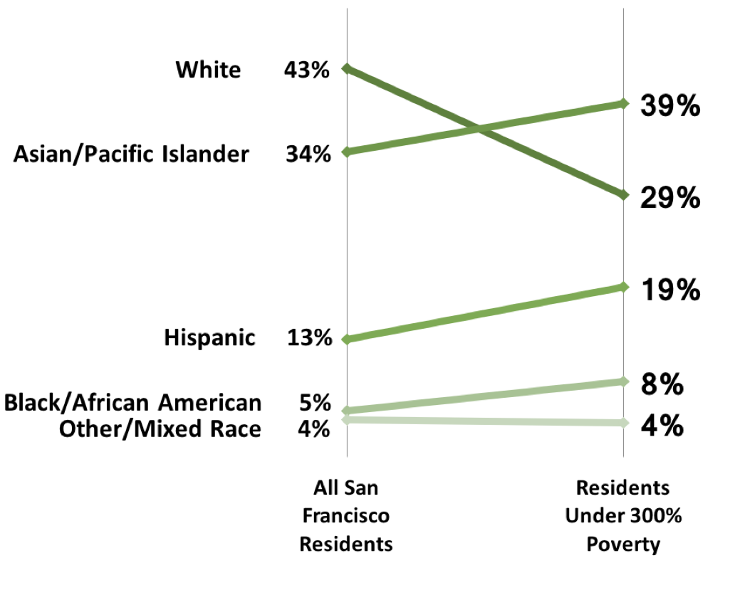
Slopegraphs

Slide 30
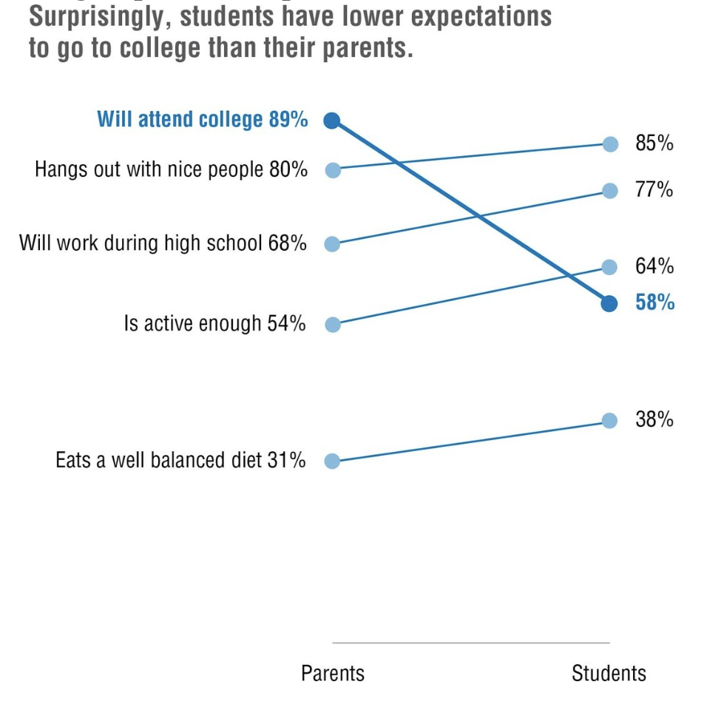
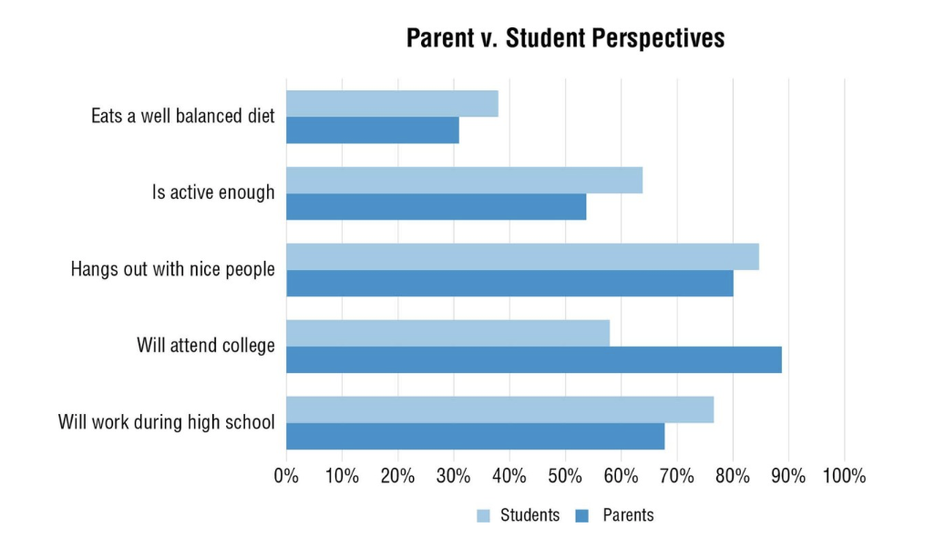
Slopegraphs

Slide 31
Slopegraph Instructions
Select design colors under the ”Page Layout” tab.
Put data into right format: two columns next to each other with numbers
Highlight Rows and Columns: A5:C10 ** don’t include Row 4**
Insert Line Graph – Make sure you’re picking “Line with Marker”
Click “Switch Row/Column” button (Right click on chart, pick “Select Data”, the button should appear)
Right click or double click on x-axis to bring up the Format Axis Toolbar
Select “Axis Options” → “Axis Position” → “On Tick Marks”
Delete y-axis & legend labels & y-axis gridlines
Increase the width of each line to 4pt under “Fill & Line” → “Border” → “Width”
Decrease the size of the “Plot Area,” Make the X-Axis labels bigger
Get rid of the outline around your graph Click on the Format Tab, find the pencil icon next to the paint can button Click on the button and select no outline

Slide 32
Slopegraphs – Adding Data Labels
Adding data labels:
Right click on the first line, click add data label
Make the font of both labels the same color as the line
Delete the left data label, make sure that you only have the left one selected
Add a text + data label for each line Insert a text box Type the text descriptor + the 2008 number, so for example the first text box should read “Black or African American, 457”
4. Or, right click on the line, pick “Format Data Labels”, and under label options, check “Series Name” Make sure the data labels and text box font color match the line of your graph
Repeat steps 1 – 5 four more times.
You can do it!

Slide 33
Agenda
Basics of Visualization
Clustered Bar Charts
Pie Charts
Slopegraphs
Benchmark Line
Butterfly Graphs
Stacked Bar Graph
Confidence Intervals
Time Stamp Line
Icon Arrays

Slide 34
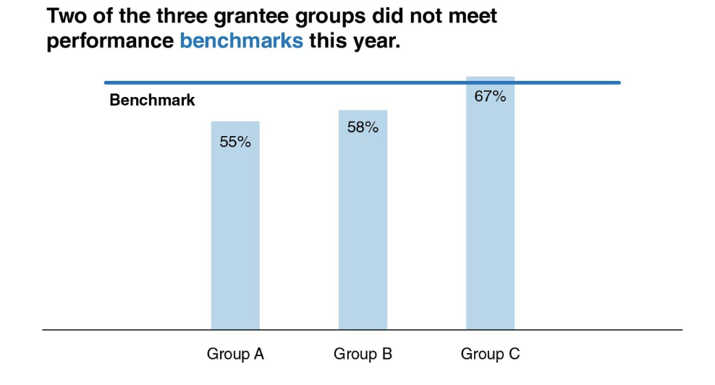
Benchmark Data

Slide 35
Benchmark Data Instructions
1 | Select design colors under the ”Page Layout” tab.
2 | Select A4:C11
3 | Insert a clustered column graph
4 | Let’s transform these clustered columns into a benchmark line! Right click on one of the 51% columns Toggle over to ”Change Series Chart Type” For Series2 (which corresponds with the 51% bars), select ”Line”. Click OK
5 | Delete the contents of cells A4 and A11
8 | Formatting Delete the y-axis label, horizontal gridlines, legend labels Expand your chart area so that all the text for the x axis labels is legible Give your chart a title Add data labels that show the percentage of votes received by each proposal, as well as the benchmark percentage

Slide 36
Agenda
Basics of Visualization
Clustered Bar Charts
Pie Charts
Slopegraphs
Benchmark Line
Butterfly Charts
Stacked Bar Graph
Confidence Intervals
Time Stamp Line
Icon Arrays

Slide 37
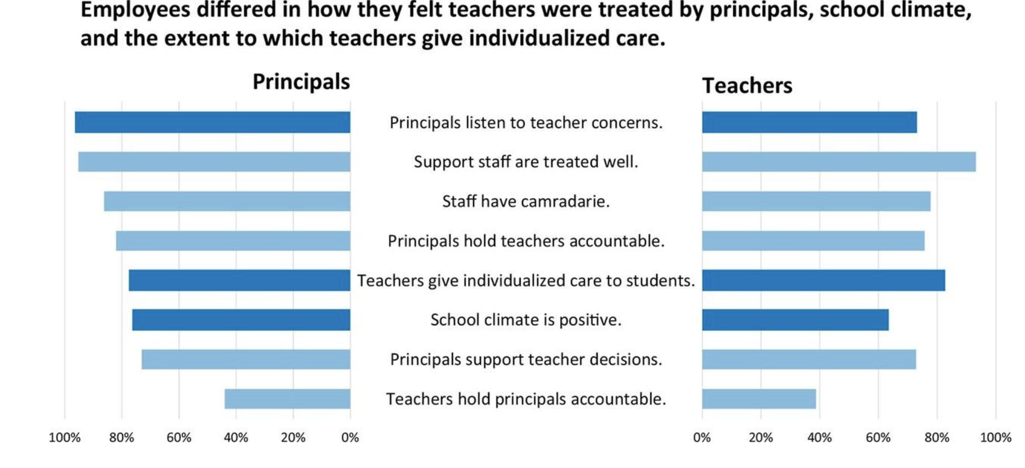
Butterfly Charts
Source: Evergreen, “Effective Data Visualization” p.48

Slide 38
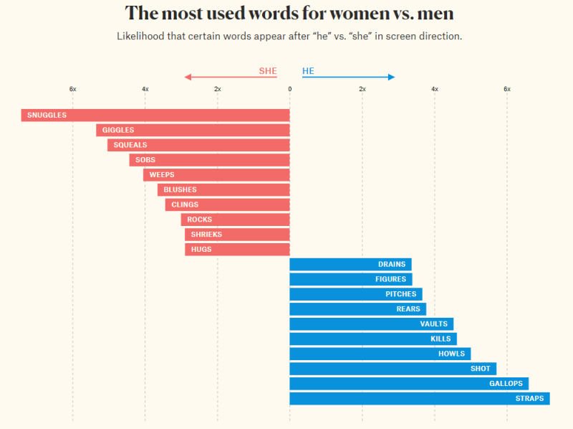
Butterfly Charts
https://pudding.cool/2017/08/screen-direction/

Slide 39
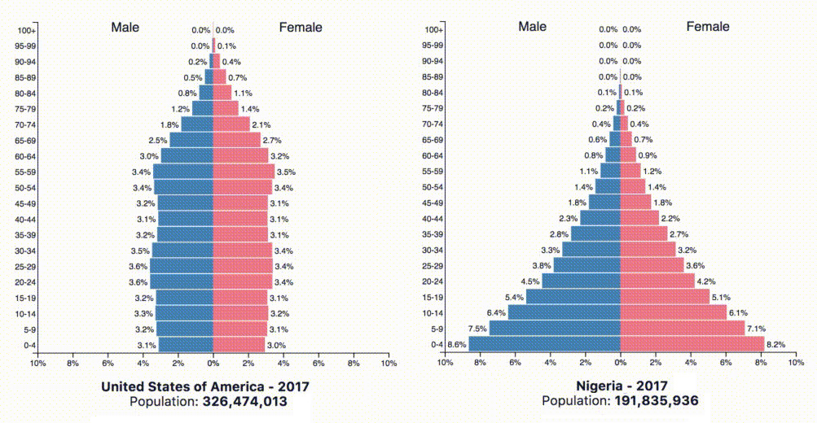
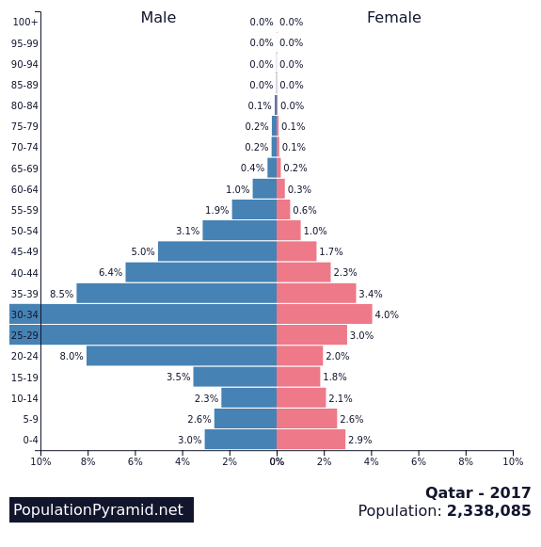
Butterfly Charts

Slide 40
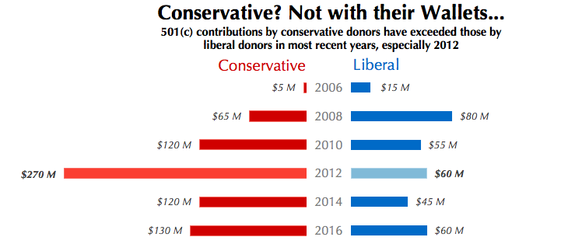
Butterfly Charts

Slide 41
Butterfly Chart Instructions
1. Start with your data in three columns: common index, group 1, group 2
2. Make a clustered bar graph with Conservative Data (B3:B9)
3. We want to flip the Conservative clustered bar graph Right click on x-axis, select “Format Axis” Under Axis Options (the graph icon), select “Values in Reverse Order”
4. Insert clustered bar graph of Liberal Data (C3:C9)
5. We need to fix the axis on our Liberal Data Right Click on x-axis, select “Format Axis” Change the maximum bound to 300
6. Delete both y-axes
7. We will now do the rest of our formatting in PowerPoint Copy and paste both charts into the PowerPoint slide labeled “Butterfly Graph Practice”
8. To make sure both graphs are aligned select both charts by first holding either CTRL or CMD button and then selecting Go to the shape format tab Click the Align button and select “Align Top” On the Home tab, select “Arrange” and then “Align” and then “Align Top”

Slide 42
Butterfly Chart Formatting Tasks
1. Delete the y-axis labels
2. Insert a text box for each year Hint: you can replicate a text box by selecting it, then pressing control and dragging it Then you can align them horizontally when you’re done making them
3. Remove the lines of your graphs + the text boxes by Right Clicking, bringing up the formatting box, then going to “Chart Options” → “Fill & Line” → “Border” → select “No line”
4. Remove the x-axis lines
5. Add data labels by selecting the bars of one graph, go to the Chart Design tab, “Add Chart Element” → “Data Labels” →
6. Pick a neutral color for each set of bars, red for conservatives (republicans) and blue for liberals (democrats)
7. Pick a stand out color for each bar for year 2012. You’re trying to highlight that 2012 was a cray year for campaign spending.
8. Add a good title.

Slide 43
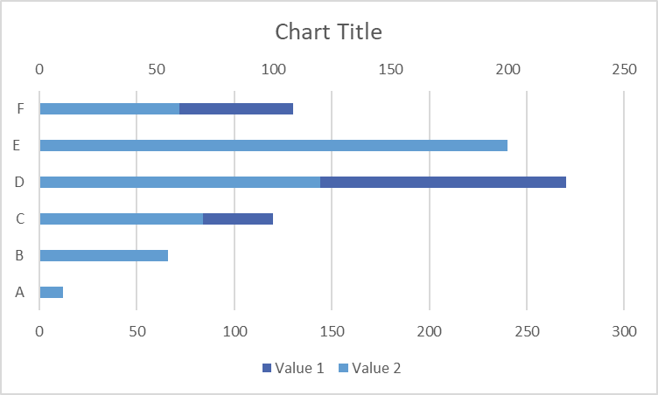
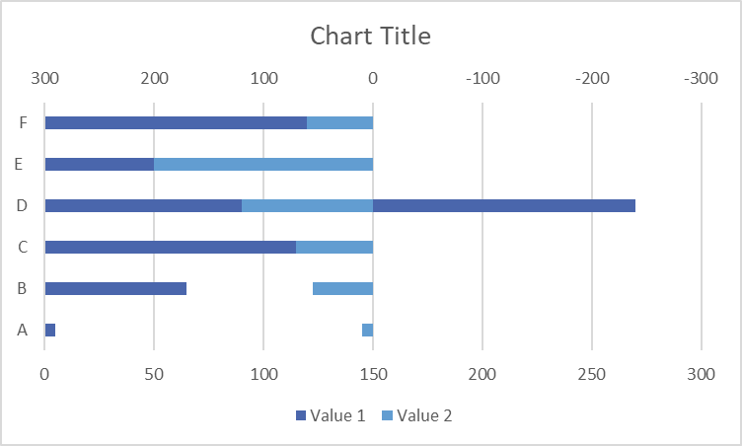
Alternate Practice: Butterfly Charts
How to create a butterfly chart in Excel:
Select your data → Insert horizontal “Clustered Column” chart
Right click on either data series → Format Data Series → Series Options → Plot Series On: Secondary Axis → OK. Your chart should look something like this, with x-axes at the top and bottom of the chart:
Right click on the x-axis at the top of the chart → Format Axis → Axis Options. Under “Bounds”, enter -300 as the minimum and 300 as the maximum. Check “show values in reverse order.” Your chart will now look something like this:
Next, right-click on the x-axis at the bottom of the chart. Format Axis → Axis Options. Likewise enter -300 as the minimum and 300 as the maximum axis bounds. This is to ensure the distance on either side of zero on your x-axis is balanced. When working with other data sets, round up from the largest value in your data and use that for your minimum/maximum bounds.

Slide 44
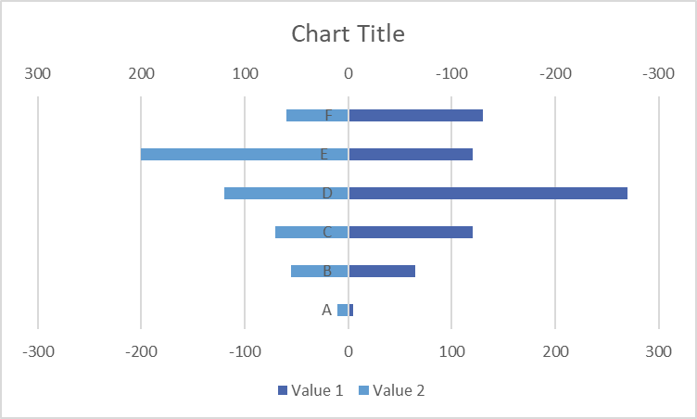
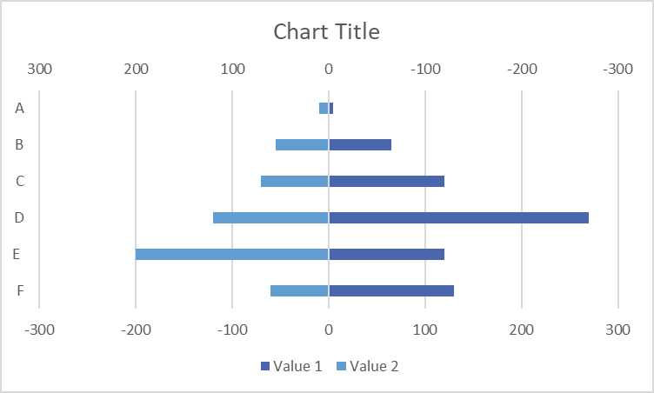
Alternate Practice: Butterfly Charts
Your chart should look something like this:
Right click on the primary vertical axis (the letters clustered around 0 at the middle of the chart). Format Axis → Axis Options → Labels. Under Labels, change “Label Position” to “Low.” The vertical axis values should now be on the left side of the graph.
This is good, but we want the smallest values to be at the top of the chart. The quickest way around this is to sort the first column in your data (the vertical axis values) in descending order. Now your chart should look like this:
Delete the x-axis at the top of the chart, you don’t need it anymore.
** Note: this step is just for aesthetic purposes – I preferred how the chart looked with the smallest values at the top. You don’t need to do this & can organize your data however you want in your own work.

Slide 45
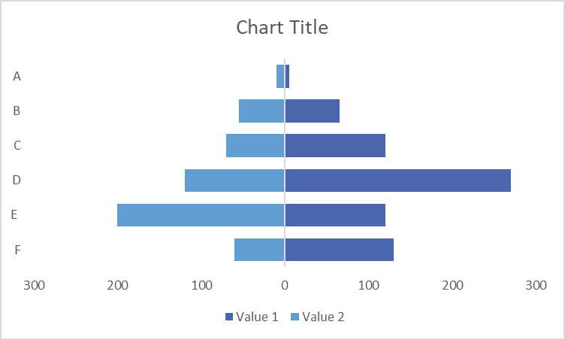
Alternate Practice: Butterfly Charts
Next, since all values in each data series are positive, we need to update the x-axis to reflect that (i.e., get rid of the negative values). Right-click on the remaining x-axis → Format Axis → Axis Options.
Under “Number”, change Category to “Custom.” Under “Format Code,” enter “$###0;$###0.” This will display the values on either side of zero as positive.
Alternative: delete this x-axis as well, and add data labels to your chart.
Formatting time!
Delete axis gridlines
Reduce the space between bars: right-click on either set of bars → Format Data Series → Adjust Gap Width (I set mine at 50%). Repeat for the other set of bars.
Add data labels as desired
Adjust colors
Yay! You’re done! Your chart should look something like this (possibly with the x-axis removed and data labels added):

Slide 46
Other options for making Butterfly (also called Tornado) Charts:
Population Pyramid template:
https://www.measureevaluation.org/resources/training/capacity-building-resources/m-e-of-malaria-programs-1/data-demand-and-use-population-pyramid-template/view
Tornado chart how-tos
https://www.excelhowto.com/how-to-create-tornado-chart-butterfly-chart/
https://www.excelhowto.com/how-to-use-clustered-bar-to-create-tornado-chart/

Slide 47
Agenda
Basics of Visualization
Clustered Bar Charts
Pie Charts
Slopegraphs
Benchmark Line
Butterfly Graphs
Stacked Bar Charts
Confidence Intervals
Time Stamp Line
Icon Arrays

Slide 48
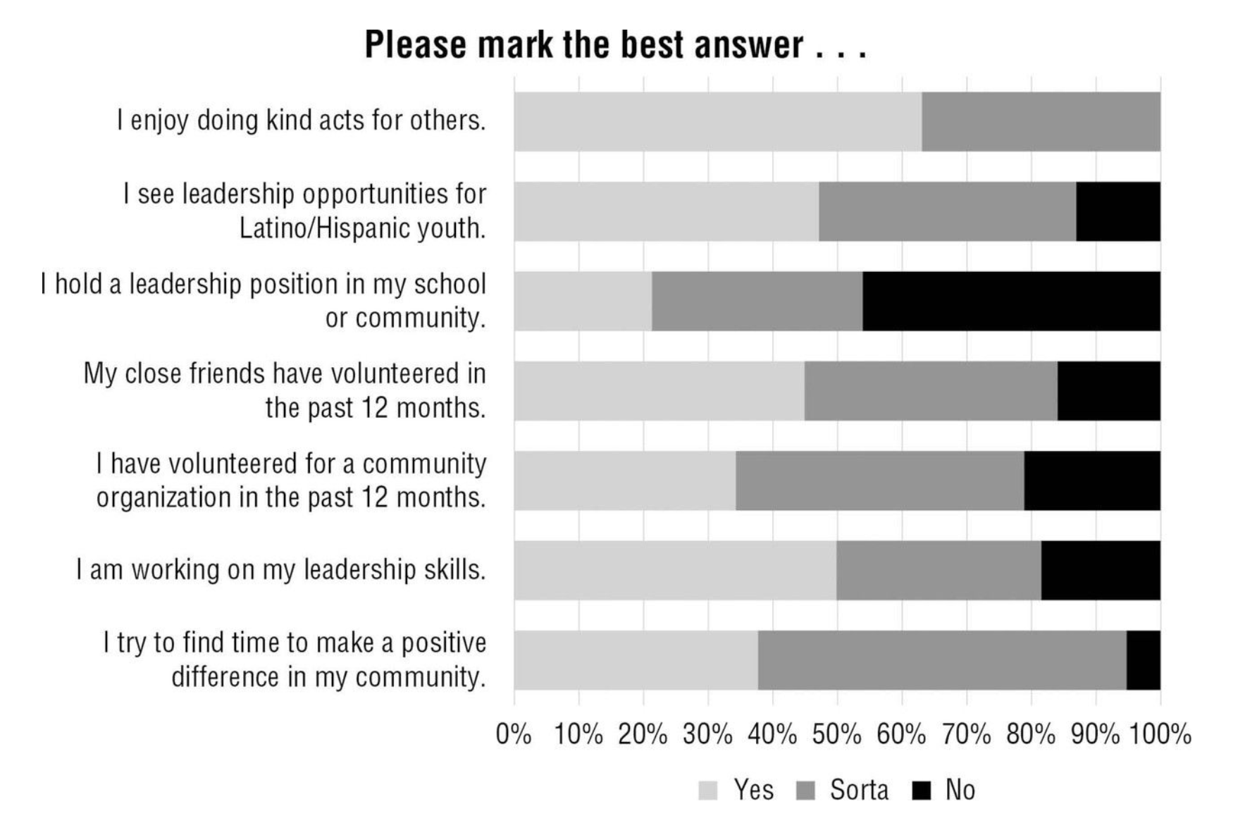
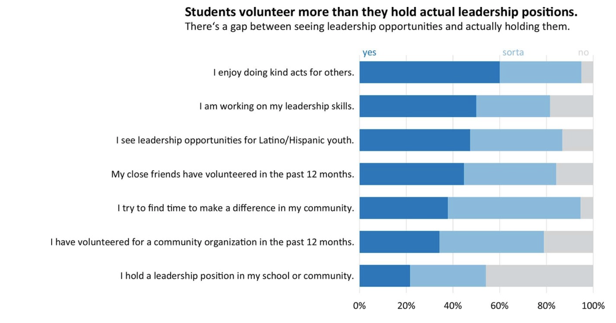
Stacked Bar Charts
The alternative to a stacked bar chart is often a clustered bar or column chart, which can allow you to compare values within each category as well as within each response. Stacked bar charts allow you to compare proportions within a category. What’s better about the chart on the right?
Source: Evergreen, “Effective Data Visualization” p.104-105

Slide 49
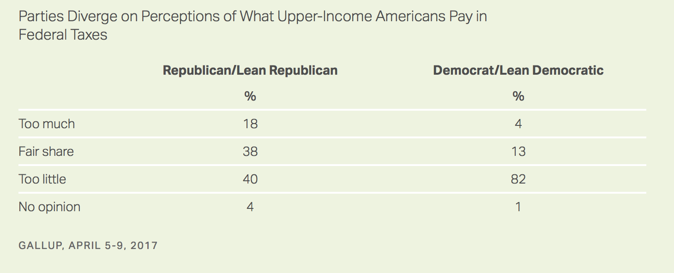
Stacked Bar Charts: Example data
Full Article

Slide 50
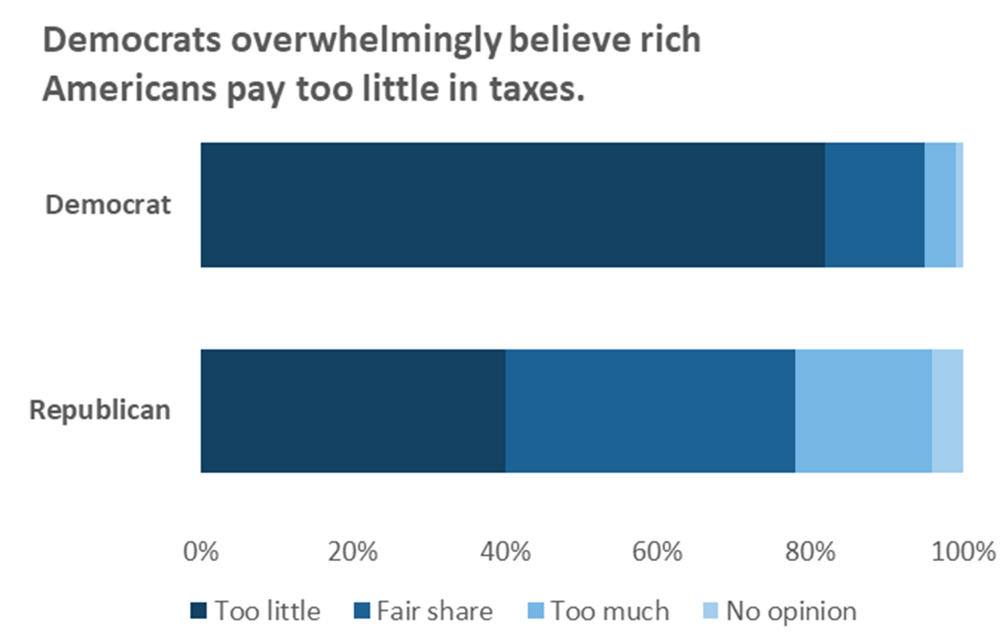
Stacked Bar Charts: Example charts
Full Article

Slide 51
Stacked Bar Chart: The Basics
Select A4:C8
Insert Stacked Bar chart
Wait! This doesn’t look right, we’re trying to understand Democrats v Republicans Under “Chart Design” tab, select the button that says “Switch Row/Column”
Add an active title, you can use the Gallup title, but it’s a little cumbersome
Delete y-axis gridlines
Darken the font of the title – Excel always chooses a light font, it’s v annoying.
Darken the y-axis line at the 0 (Hint: Need to select the y-axes labels, then find the paint can icon in the formatting menu.)

Slide 52
Stacked Bar Chart: Formatting
Sort the data based on the information you’re trying to pull out The biggest difference here is that Republicans and Democrats have wildly different views on whether or not Upper-Income Americans pay too little in taxes Select A5:C8 & click on the sort button Under Column, select Democrat / Lean Democrat Under Order, select Largest to smallest, hit Ok
Pick a new color scheme I like monochromatic, but the “Change Colors” feature sometimes isn’t enough contrast, if that’s the case then do the following: For ”Too Little” select a dark color Make “Fair Share” and “Too Much” lighter versions in the same column Make “No Opinion” a light grey
The legend is ugly, let’s delete it then make new labels using linked text boxes Insert a text box above the portion of the bar delineating “too little” In the formula bar (fx) type “=”, then select cell A5 Make the font match the color of the bar
Repeat the same steps above for the label “Fair Share”

Slide 53
Agenda
Basics of Visualization
Clustered Bar Charts
Pie Charts
Slopegraphs
Benchmark Line
Butterfly Charts
Stacked Bar Charts
Confidence Intervals
Time Stamp Line
Icon Arrays

Slide 54
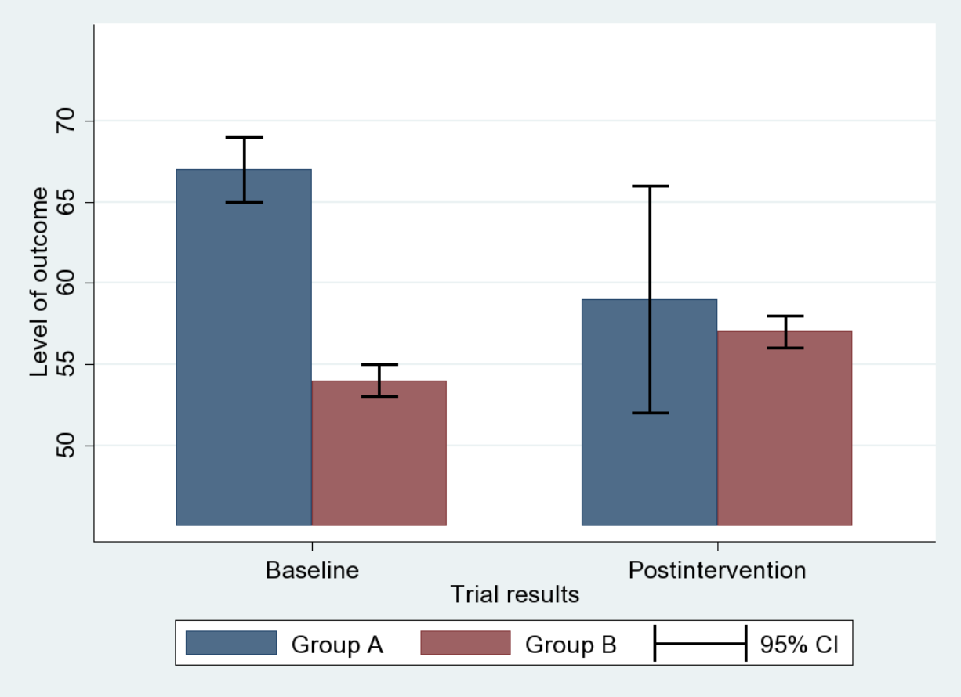
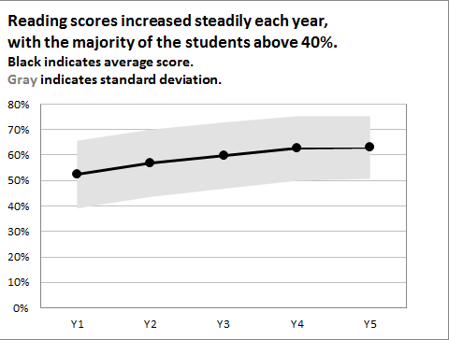
Confidence Intervals
Using bars for ranges: can be good at showing overlap between categories (if you have discrete categories)
Using shaded confidence interval: can show uncertainty over a continuous dataset
Other ways to represent uncertainty in data (other than confidence intervals): showing data distributions through histograms
Source: Evergreen, “Effective Data Visualization” p.30

Slide 55
Confidence Interval Instructions
Select A8:C11 A8:B11
Insert Line Graph (with markers) Insert clustered column graph
We’re going to delete the line of the program results (trust me) Double click anywhere on the line that shows the results data Under the paint can icon, select “no line” Also toggle to markers– select no fill, no line
Let’s make our program markers bigger Toggle over to markers Select “Built in” under “Marker Options” Change the size to 10, and the type if you please
Let’s fix the y-axis Select the y-axis, toggle over to the chart icon Change maximum bound from 0.8 to 1.0
Let’s make the y-axis labels in percents In the same dialogue box, expand the “Number” heading Change the category from general to percentage Change the decimal places number from 2 to 0

Slide 56
Confidence Interval Instructions – Continued
We’re now going to add error bars, aka confidence intervals
Select one of the results icons so that the Chart Design tab pops up, click on it.
At the very far left of the tab, click the button that says “Add chart element”
Toggle down to error bars, and select “more error bar options”
Make sure that you’re in the tab under format options with the graph icon Under Error Amount, select custom, and click on the button that says specify value A dialogue box will pop up called “Custom Error Bars”
In the “Custom Error Bars” box [IMPORTANT– DO THIS BY CLICKING ON THE ICONS] Positive Error Value: select D8:D11 Negative Error Value: select D8:D11 Click ok Then, to see the error bars, format the data series to have solid fill, and adjust transparency

Slide 57
Alternate Practice: Graphing Confidence Intervals
Option 1 - How to create a simple graph with error bars:
Select cells A9:B12
Insert → Clustered Column → Change chart type of benchmark bars to a line.
Add the error bars: Add Chart Element → Error Bars. You’ll see that error bars have been added to your chart, but they are incorrect and need to be fixed.
Click on the bars to bring up the Error Bar Options window. Scroll all the way down and select “Custom” → Specify Value
For both the positive and negative error value inputs, select cells D9:D12
The important part is over! Now it’s just formatting.

Slide 58
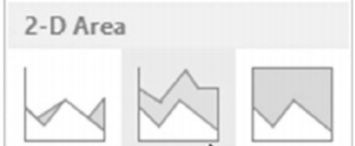
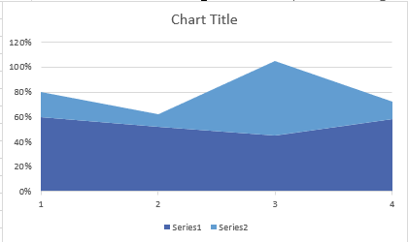
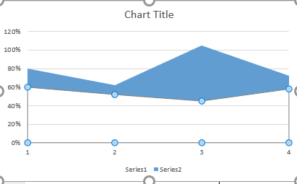
Alternate Practice: Graphing Confidence Intervals
Option 2 – How to create a chart with “area” error bars (third chart shown 2 slides back):
Highlight cells E9:F12 → Insert a Stacked Area Chart (found under line chart icon)
Click on the lower range data series → Format Data Series → Fill = No Fill
Change the color of the “full range” data series to an unobtrusive light grey
Add the means: right click on your chart → Select Data → Add → set series name “Means” & set values as cells B9:B12

Slide 59
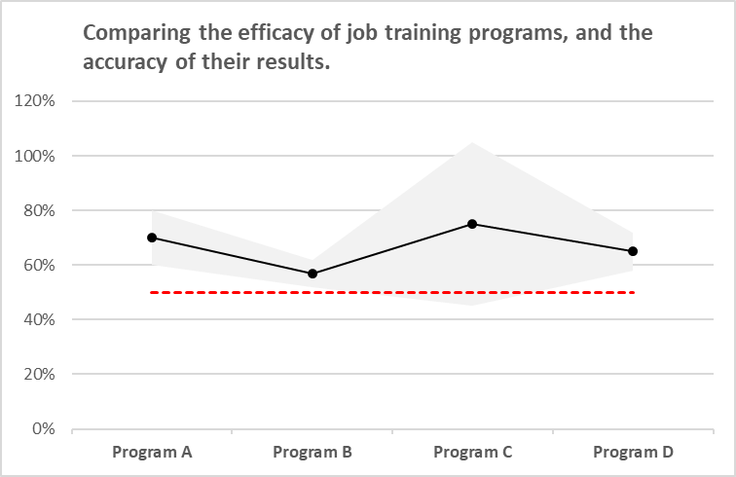
Alternate Practice: Graphing Confidence Intervals
Option 2 – How to create a chart with “area” error bars (third chart shown 2 slides back):
Click the “edit” button under “Horizontal (Category) Axis Labels” and highlight cells A9:A12 → OK
Right click on the “means” data series on your chart → Change Series Chart Type → Line with Markers → OK
Add the benchmark line: right click on your chart → Select Data → enter series name “Benchmark” & input cells C9:C12 under series values
You’re done! Now it’s all formatting from here.

Slide 60
Agenda
Basics of Visualization
Clustered Bar Charts
Pie Charts
Slopegraphs
Benchmark Line
Butterfly Charts
Stacked Bar Charts
Confidence Intervals
Time Stamp Line
Icon Arrays

Slide 61
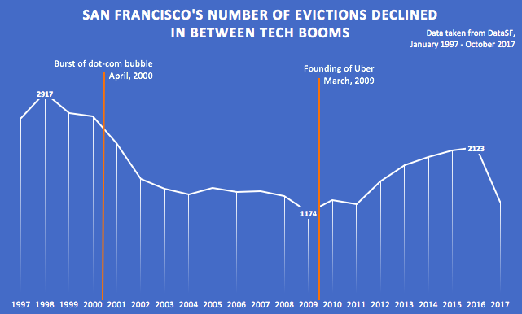
Time Stamps

Slide 62
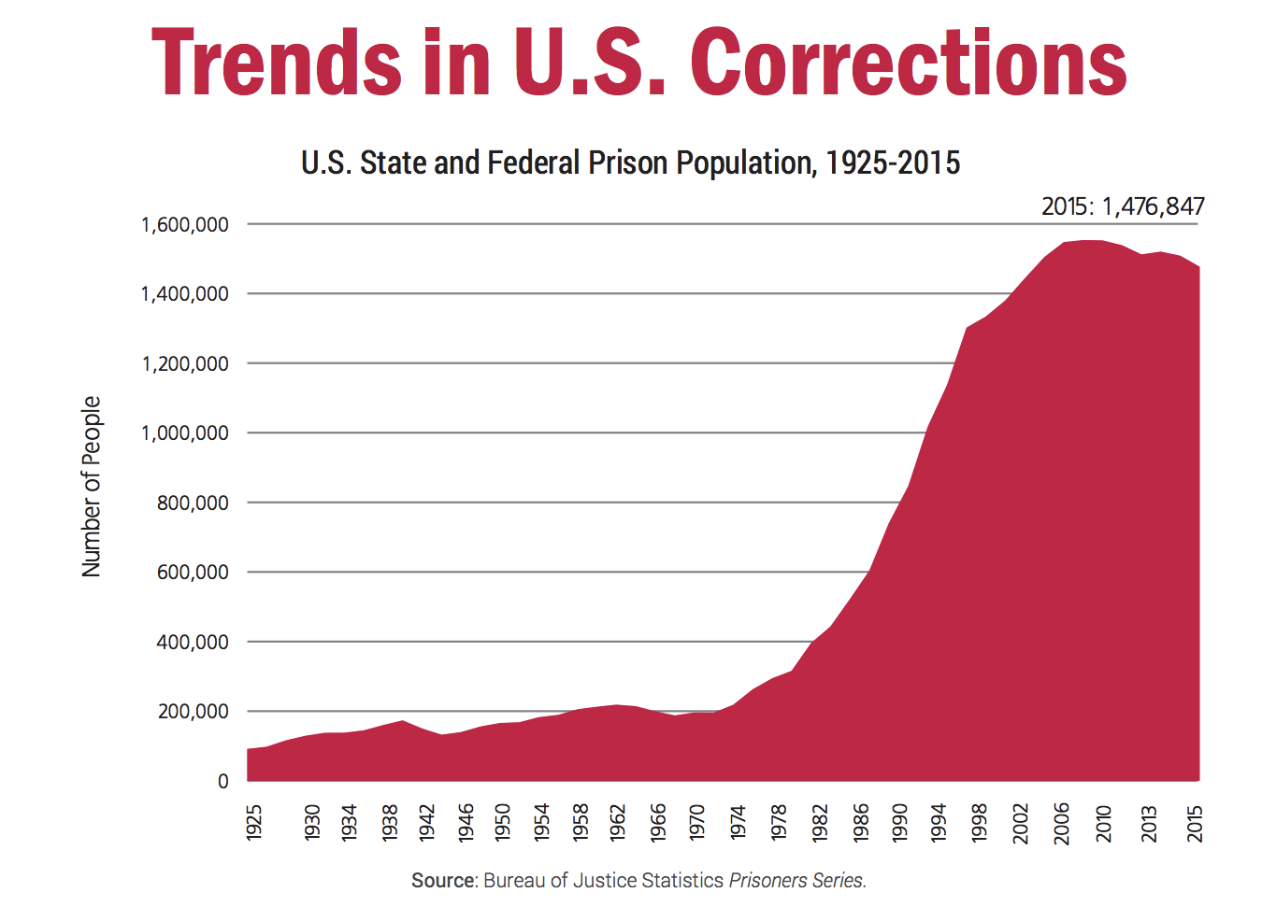
Time Stamps

Slide 63
Time Stamp Instructions
Draw a line under the insert tab Select the line under the shapes button Eyeball where it should go
Formatting trick – let’s change x-axis labels to show years (if it doesn’t already( Right click on x-axis labels Click select data Where it says Horizontal (Category) axis labels, select cells A2:A7 Press ok To figure out where to place the time stamp line exactly, we can add more tick marks on the x-axis Double click on the x-axis labels Under the chart icon in format axis, navigate to Axis Options Under Axis Type, select “Date Axis” Now the graph will show dates at a higher resolution – you can place the line in the correct location

Slide 64
Agenda
Basics of Visualization
Clustered Bar Charts
Pie Charts
Slopegraphs
Benchmark Line
Butterfly Charts
Stacked Bar Charts
Confidence Intervals
Time Stamp Line
Icon Arrays

Slide 65
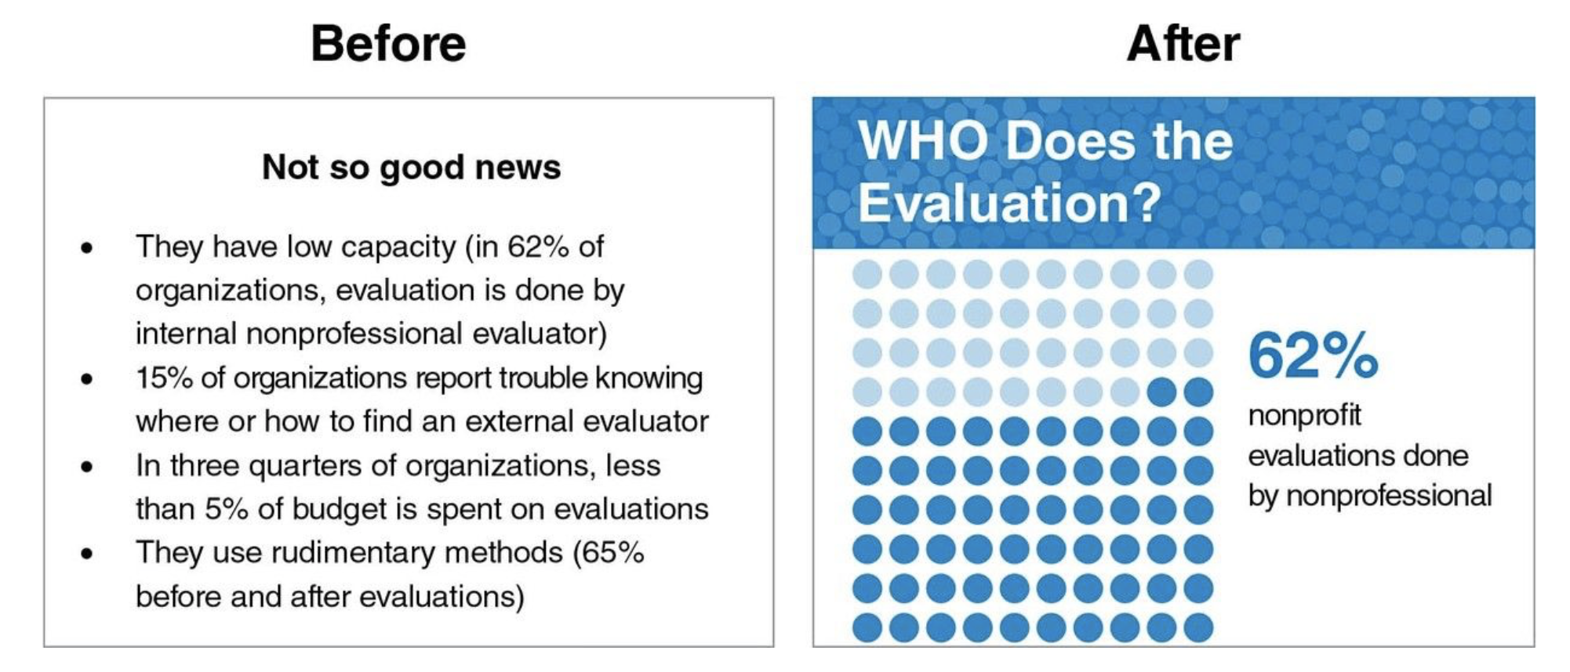
Icon Arrays
Source: Evergreen, “Effective Data Visualization” p.14

Slide 66

Icon Arrays - Examples
http://blog.visme.co/pictograph-maker/

Slide 67
Icon Arrays - Examples
Example of what I don’t like
Too many colors
Icons are distracting, I would split up these statistics, or maybe choose different icons

Slide 68
Icon Arrays
Statistic we want to turn into an icon array:
In 2015, 60% of Georgians polled answered ’yes’ to the following question: Do the media in this country have a lot of freedom, or not?
Data Source (Gallup Poll about media perceptions around the world )

Slide 69
Icon Arrays – see next slide
Select the icon you want to use ** Check out the appendix of the PowerPoint
Duplicate it 9 times Click on the shape Hold down on the ctrl button, while using your mouse to drag the shape
Align all shapes Find the align icon on under the Shape tab (you must be clicked into the shape for this tab to appear) Select “Align Horizontally” (Come back and play around with this button later, it’s v cool.)
Change the color of 6 of the shapes to underscore the fact you’re trying to convey
Add text box: “In Georgia, 6 out of 10 people believe the media in their country has a lot of freedom.” Or a text box better than mine, I won’t be offended.
Try different formatting techniques Make the number match the color of the shapes representing the statistic Make words stand out using bold, italic, a different font, etc.

Slide 70

Icon Array Resources
http://www.iconarray.com/
Free online icon array maker from UM, also does a great job summarizing the research
https://thenounproject.com/ FREE
https://www.flaticon.com/ ALSO FREE
http://www.vizhealth.org/wizard/
Really cool visualization builder for health related policy issues

Slide 71



Visualization Resources
Anything by Edward Tufte or David McCandless
Stephanie Evergreen’s Effective Data Visualization & Presenting Data Effectively
What chart to pick? See this outline of chart types for different purposes; also, From Data to Viz
Check out some of the sites that let you make infographics, like Piktochart—you can combine different visualizations to make a story
Pay attention to visualizations in publications that are great at them—the New York Times, the Wall Street Journal, and others
May you always have Excel! But if not, try https://rawgraphs.io/
Make sure your visualizations are accessible to all!
Who doesn’t love a sing-along? http://tinyurl.com/sallygoredataviz

Slide 72
Thank you!
FURTHER RESOURCES FOR LEARNING EXCEL (BESIDES ASKING THE D-LAB FOR HELP):
--LinkedIn Learning, available from the UC Berkeley Library (must be logged in as Berkeley user to access)
--For employees: check out these offerings! https://hr.berkeley.edu/development/learning/techsystems You can also search “Excel” in the UC Learning Center. Anything Keith Samsell offers is brilliant.
--UC Berkeley Library Research Guide to Data Visualization, including a section on Excel (and/or, come to the D-Lab’s Visualization in Excel class on 4/28/20!)
--Ebooks from UC Berkeley:
Beginning Excel (from the Open Textbook Library)
Learn Office 2016 for Mac
How to Use Microsoft Excel
Excel Data Analysis: Modeling and Simulation
--Videos:
“Beginner Excel” search on YouTube.com! Be a careful consumer, but generally these are good;
otherwise, stick with LinkedIn Learning.

Slide 73
Appendix of Icon Examples
[NOT SURE OF SOURCE—
REFERENCE USE ONLY]

Slide 74
Icons
Icons can be used within infographics or as navigational aids. They should not be used as image replacements.

Slide 75
Icons (continued)
Icons can be used within infographics or as navigational aids. They should not be used as image replacements.

Slide 76
Icons
Icons can be used within infographics or as navigational aids. They should not be used as image replacements.

Slide 77
Icons (continued)
Icons can be used within infographics or as navigational aids. They should not be used as image replacements.
Financial services
Manufacturing/Retail
Life science/Healthcare

Slide 78
Icons (continued)
Icons can be used within infographics or as navigational aids. They should not be used as image replacements.
Real estate
Public sector
Technology, media, and telecommunications

Slide 79
Icons (continued)
Icons can be used within infographics or as navigational aids. They should not be used as image replacements.
Transportation/Journey
Energy/Environment
Education/Talent

Slide 80
Icons (continued)
Icons can be used within infographics or as navigational aids. They should not be used as image replacements.
Office
Social Media

Slide 81
Icons (continued)
Icons can be used within infographics or as navigational aids. They should not be used as image replacements.
Symbols

